Slide 1

How to do a Systematic Review
Holly Cook
Clinical Librarian

Slide 2
What I’ll cover today
What is a systematic review?
How to do one
Planning
Searching
Format/writing
Getting published

Slide 3
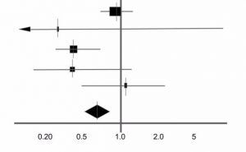
What I won’t cover…
Detailed instruction on how to do a meta-analysis

Slide 4

History
The first systematic review was conducted by James Lind in 1753 (following his clinical trial of 1747) “Treatise of Scurvy”
In the 1970’s UK, Archie Cochrane said that “healthcare in the NHS must be properly evaluated and shown to be clinically effective before use”
Cochrane AL (1972) Effectiveness and efficiency: random reflections on health services. London: Royal Society of Medicine Press.
At a similar time in the USA, Gene Glass developed the meta-analysis
Glass GV, Smith ML (1979) Meta-analysis of research on the relationship of class-size and achievement. Educational Evaluation and Policy Analysis 1: 2-16.
1st Review!

Slide 5
What is a systematic review?
A systematic review attempts to identify, appraise and synthesize all the empirical evidence that meets pre-specified eligibility criteria to answer a specific research question. Researchers conducting systematic reviews use explicit, systematic methods that are selected with a view aimed at minimizing bias, to produce more reliable findings to inform decision making.
Not ‘just’ a review of the literature…
A piece of research using rigorous methodology
Uses the best evidence (usually RCT’s) to answer a research question

Slide 6
Systematic Review
Description
Search approach
Combines strength of critical review with exhaustive search processes.
Addresses broad questions to produce ‘best evidence synthesis’
Exhaustive search strategies

Slide 7
Literature Review
Description
Search Approach
Examines recent or current literature. Can cover wide range of subjects at various levels of completeness and exhaustivity. May include research findings.
Can be exhaustive but is not a requirement

Slide 8
Mapping Review
Description
Search Approach
Maps out and categorises existing literature from which to commission further reviews and/or primary research by identifying gaps in the research literature
As time allows

Slide 9
Meta-analysis
Description
Search approach
Statistically combines results of quantitative studies to provide precise effects of results
Exhaustive. May use funnel plot to assess completeness.

Slide 10
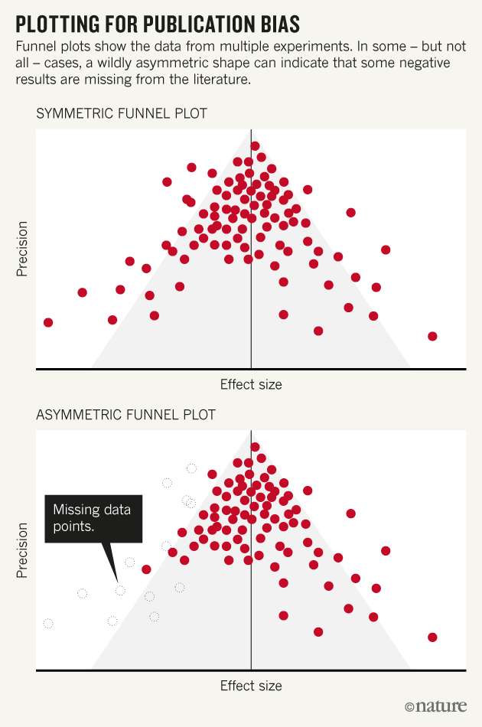
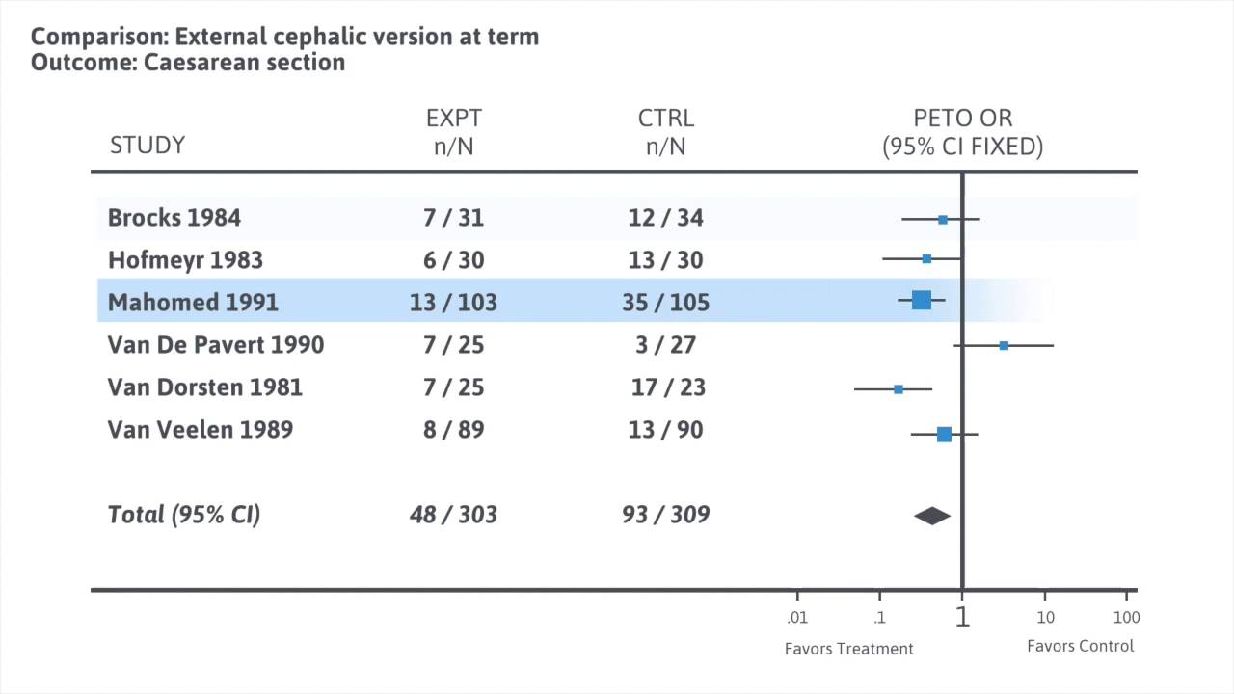
Meta-analysis statistical tools
Forest Plot
Funnel Plot

Slide 11
Umbrella review
Description
Search approach
Summarises results from systematic reviews on a topic
Exhaustive search for reviews only.

Slide 12
Rapid Review
Description
Search approach
Rapidly assesses what is already about policy or practice.
Uses accelerated or abbreviated methods as compared to a systematic review.

Slide 13
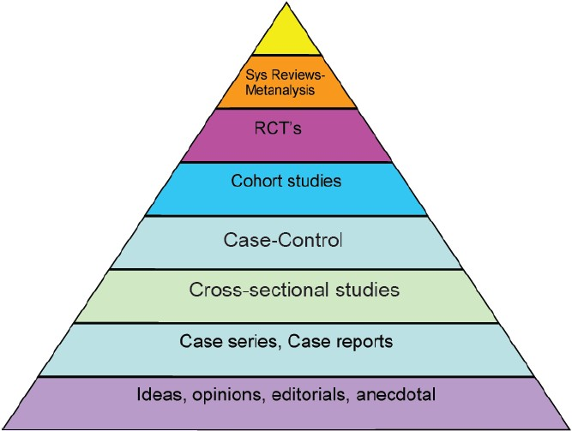
Why are they important?

Slide 14
Advantages
You are in control of your learning objectives and your project
You can focus on a topic that you’re interested in
You don’t have to gain formal ethical approval for your review before you begin
You don’t have to recruit participants
You can gain understanding of a number of different research methodologies
You can gain insight into the strengths and limitations of published literature
You can develop your critical appraisal skills
The research can fit in, and around, your family (or social) life

Slide 15
Disadvantages
You don’t experience writing and defending an ethics application
It can be isolating as you are likely to be primarily working on your own
You don’t face the challenge of recruiting participants
You may not get a sense of the topic in terms of lived experience
You are reliant on the quality and quantity of available published information to address your research question
You may find the process dull or boring at times
There are no short cuts and the process is time consuming
Boland, A., Doing a Systematic Review, 2nd edition. London: SAGE.
Notes:
Lived experience – only so much ‘experience and understanding’ you get from a paper.
You are reliant on the quality of other peoples research. So much critical appraisal…

Slide 16
Features of a Systematic Review
Authors: At least 2 (often more), preferably combining experts in the topics of interest and experts in the methodology of systematic review
Study protocol: A published study protocol which includes a detailed plan of rigorous methods.
Research question: A specific question which can be broken down into concepts such as PICO
Search Strategy: A comprehensive and repeatable search strategy. Uses multiple databases and other sources of published and unpublished literature without language restrictions.

Slide 17
Features of a Systematic Review
Selection criteria: The criteria for inclusion and exclusion of studies are specific and agreed in advance.
Critical appraisal: Includes a systematic and thorough appraisal of the quality or risk of bias in the included studies.
Synthesis: includes qualitative (narrative) synthesis and/or quantitative pooling of data in meta-analysis, with consideration given to the relative precision and quality of the included studies.

Slide 18

The Question

Slide 19

Is your question well defined?
Essentially your question will determine your:
Eligibility criteria
Search strategy
Analysis of the results
Interpretation and presentation
It will determine bias

Slide 20
Types of review questions
Intervention review: compares two or more interventions on a range of different outcomes (or to compare an intervention with no outcome at all)
Diagnostic test accuracy review: assesses how well a diagnostic test performs in detecting a particular disease
Prognostic review: assesses the probable course or future outcomes for people with a specific health problem.
Methodological review: will address questions about how research is conducted and reported.
Qualitative review: synthesises evidence from other sources such as interviews, focus groups etc.

Slide 21
Narrow vs Broad
Narrow question example:
Is aspirin effective in decreasing the risks of a particular thrombotic event, stroke, in elderly persons with a previous history of stroke?
Broad question example:
Are antiplatelet agents effective in preventing thrombotic events in humans?

Slide 22
Narrow vs Broad
Narrow
Broad
Advantages:
Easier to do
One thing at a time
Easier to read
Disadvantages:
May need multiple reviews to answer all the questions or to compare the treatment options
Advantages:
More comprehensive
Allows for variations (that will always be there)
Disadvantages:
More complex
Can miss detail
More difficult

Slide 23
Concepts / PICO
Participants: Who are you interested in studying in your review?
Interventions: What is the intervention or group of interventions you want to test?
Comparisons: What will the interventions be compared to?
Outcomes: What outcomes will tell you which intervention is the most effective?

Slide 24

Where to start?

Slide 25
Steps in conducting a systematic review
Define the question: PICO or similar
Scoping/Mapping review: Is it valid? Has it been done already?
Register title: register the title with a Cochrane Review Group to prevent duplication, see also Joanna Briggs and PROSPERO databases.
Plan review: select your inclusion criteria, identify resources etc.
Publish protocol: Protocols for systematic reviews can be registered with the PROSPERO register
Conduct review: run your search, sift and identify studies, assess for bias and then analyse and interpret their results – write up sections as you go.
Publish review: Choose the most appropriate journal/platform

Slide 26

Searching
You have done your exploratory searches, you have a clearly defined question and you have clear (maybe) published research methodology.
Aim = to create a repeatable search strategy
Concepts
Keywords
Test Search
Databases
Additional searching

Slide 27
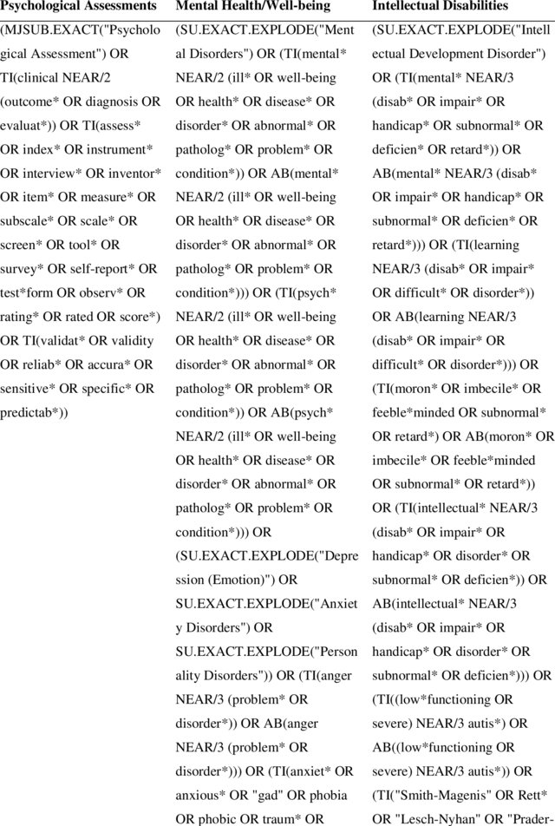
Concepts
Measurement tools for mental health problems and mental well-being in people with severe or profound intellectual disabilities: A systematic review

Slide 28
Keywords
Keywords form the basis of your search. For each of your concepts you will need to find synonyms
MeSH databases
Pubmed Reminer
Other articles
Database thesaurus

Slide 29
MeSH – Medical Subject Headings
Neoplasms, Colorectal
Colorectal Neoplasm
Neoplasm, Colorectal
Colorectal Tumors
Colorectal Tumor
Tumor, Colorectal
Tumors, Colorectal
Colorectal Carcinoma
Carcinoma, Colorectal
Carcinomas, Colorectal
Colorectal Carcinomas
Colorectal Cancer
Cancer, Colorectal
Cancers, Colorectal
Colorectal Cancers

Slide 30
Create a Test Search
The idea is to create a repeatable search strategy which you can use across different databases. You may want to test the accuracy/robustness of this search.
You can create a ‘test search’
Find about 10 articles in this field
Your search strategy should return these articles
If it doesn’t then there is something wrong with your strategy
Compare the abstract text of your article and your keywords and tweak where necessary.
Remember your search will usually only search titles and abstracts unless you tell it otherwise (not recommended!)

Slide 31
Databases
The difference between Medline and PubMed
Medline is the National Library of Medicine journal citation database and includes citations from more than 5200 scholarly journals published around the world. It has more than 25 million references to biomedical and life sciences journal articles back to 1946.
PubMed is an interface for Medline but also includes ‘ahead of publication’ citations and other ‘out of scope’ articles such as astrophysics or plate tectonics which appear in general science and chemistry journals. Also uses different algorithms.

Slide 32
Databases
AMED – Allied and Complementary Medicine 1985 to present
CINAHL - Cumulative Index to Nursing and Allied Health Literature 1981 to present
EMBASE - Excerpta Medica Database 1974 to present
EMCARE - 1995 to present
HMIC - Health Management Information Consortium 1979 to present
Medline - 1946 to present
PubMed - Medline from PubMed 1946 to present

Slide 33
Additional searching
Snowballing
Use one article to find others (cited by, similar articles etc)
Hand searching
Looking at ‘table of contents’ in relevant journals (some of the smaller society type journals may not be indexed in the databases) 😱
Grey literature
Includes: Reports, Conference Abstracts, Dissertations & Theses, Registered Clinical Trials, Interviews, Patents, Newsletters, White Papers, Book Chapters. There is often data in Grey Literature which you won’t find in published sources. By including Grey Literature in your review you will minimise publication bias and will increase the currency and accuracy of your review.
Experts
Ask an expert for any knowledge of unpublished data

Slide 34
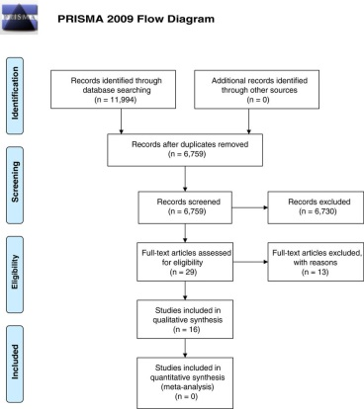
Sifting / PRISMA

Slide 35
Critical Appraisal
Critically Appraise EVERYTHING
Peer Review isn’t what it used to be!
Academic Publishing is lucrative
Make sure that the study has answered the question it has asked
Use a selection tool such as JADAD
CASP provides checklists for each study design
Check your own statistics
Do your studies have similar levels of heterogeneity?

Slide 36

Synthesising your results
Meta-Analysis or Narrative Synthesis?

Slide 37

Meta-analysis statistical tools
Forest Plot
Funnel Plot

Slide 38
Writing up
Journals will ask you to follow a particular format and will usually give you section headings to conform to such as:
Title page
Abstract
Keywords
Background
Methods
Results
Discussion
Conclusion
List of abbreviations
Declarations
References
Figures, tables and dataset

Slide 39
Getting Published
Make sure you are submitting to the most suitable journal
Look at your citations - where have they published?
Journal type: Subscription model or Open Access?
Make datasets (your search strategies, search results etc) available or include in your manuscript
Don’t worry if you get rejected, just try elsewhere…

Slide 40
To conclude….
Not a linear process – lots of to-ing and fro-ing
Planning and preparation is everything
Do your (pre)-research
Don’t try it alone – when do you ever see single author SR?
Publishing your protocol will make it easier for you to get your review published
Critically appraise EVERYTHING
Write as you go…
Be realistic about publication

Slide 41
Any questions?
Holly Cook
Clinical Librarian
Extension: 3398
holly.cook3@nhs.net

Slide 42
Useful links
What is a systematic review? (Cochrane)
https://www.cochranelibrary.com
Developing review questions and planning the systematic review (NICE)
https://www.nice.org.uk/process/pmg6/chapter/developing-review-questions-and-planning-the-systematic-review
7 steps to publishing in a scientific journal by By Aijaz A. Shaikh
https://www.elsevier.com/connect/7-steps-to-publishing-in-a-scientific-journal
PRISMA flow diagram and checklist
http://www.prisma-statement.org/
BioMed Central submission criteria
https://systematicreviewsjournal.biomedcentral.com/submission-guidelines/preparing-your-manuscript/research

Slide 43
Useful links
MeSH database
https://www.ncbi.nlm.nih.gov/mesh
PubMed Reminer
https://hgserver2.amc.nl/cgi-bin/miner/miner2.cgi
Oxford Quality Scoring System (JADAD)
https://www.rcemlearning.co.uk/modules/critical-appraisal-appraising-a-treatment-early-goal-directed-therapy/lessons/methodology-jadad-scores/topic/jadad-scores/

