Slide 1

Student Nursing Associates (SNA)
Not offering in 2025/26
A role within the nursing team
The SNA programme
The Nursing Associate is a member of the nursing team in England designed to help bridge the gap between healthcare assistants and registered nurses.
Nursing Associate is a stand-alone role that will also provide a progression route into graduate level nursing.
Nursing Associates work with people of all ages and in a variety of settings in health and social care, which may include adult, child, mental health and learning disabilities nursing.
The role contributes to the core work of nursing, freeing up registered nurses to focus on more complex clinical care.
The foundation degree apprenticeship programme is delivered at the university and is,
Two years, full time – 50% theory/50% practice
Minimum of 2,300 programme hours
Trainees have practice days allocated within base areas and spoke placement areas
Trainees will attend university one or two days per week dependent on University and have built into their programme a series of supernumerary days.
For further information, please contact the Vocational Learning and Development Team: ecn-tr.vldt@nhs.net

Slide 2
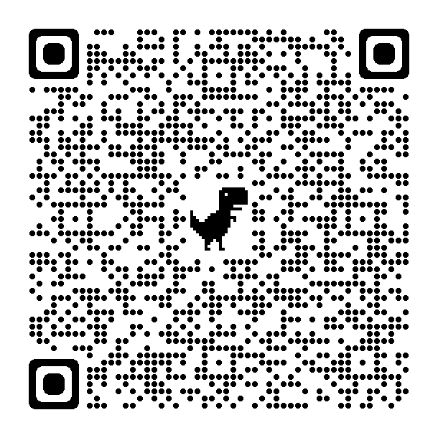
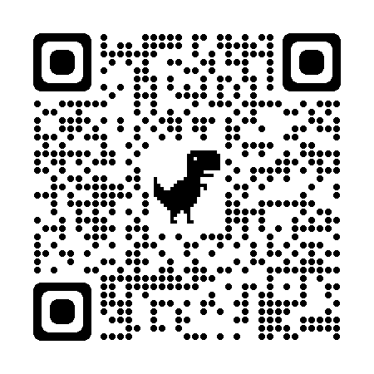
Practice Assessment for SNA’s
NMC proficiencies will be assessed throughout the two-year programme
SNA’s will be supported and assessed in practice, by Practice Assessors and Practice Supervisors. Academic Assessors will liaise with the Practice Assessor to confirm achievement.
Use your device/smartphone camera to scan the QR code to access all the information.
www.nmc.org.uk/standards/nursing-associates
www.onlinepare.net
Student Nursing Associate
Academic Assessor
Practice Supervisor
Practice Assessor

Slide 3
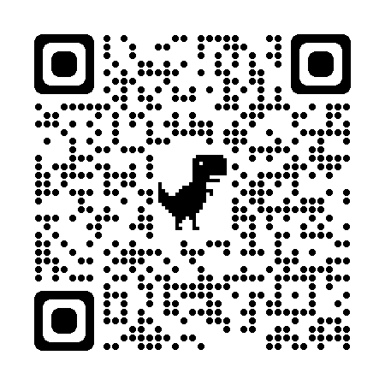
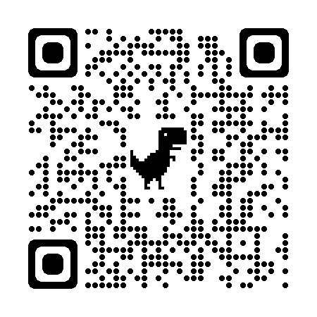

SNA entry requirements
Applicants must possess,
GCSE Maths and English at Grade 5 (Grade C) and above or,
Level 2 equivalent, for example, functional skills
Applicants must also possess one of the following (or equivalent)
NVQ Level 3 in Care or related subject or, appropriate care experience
1 A Level or 2 AS Level in an appropriate subject level
AVCE or BTEC National Diploma
QAA recognised Access course.
https://www.hee.nhs.uk/our-work/nursing-associates
https://www.nmc.org.uk/about-us/our-role/who-we-regulate/nursing-associates/

