Slide 1

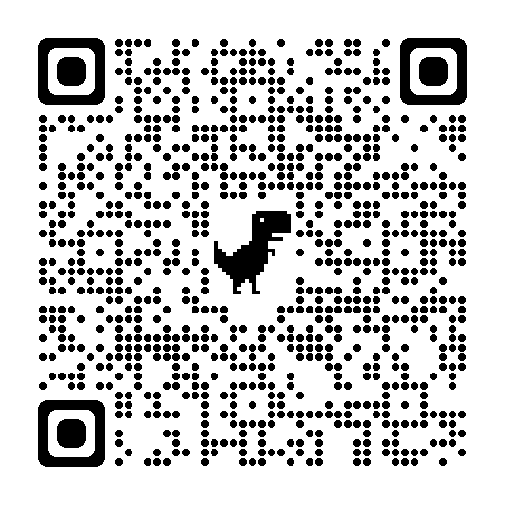
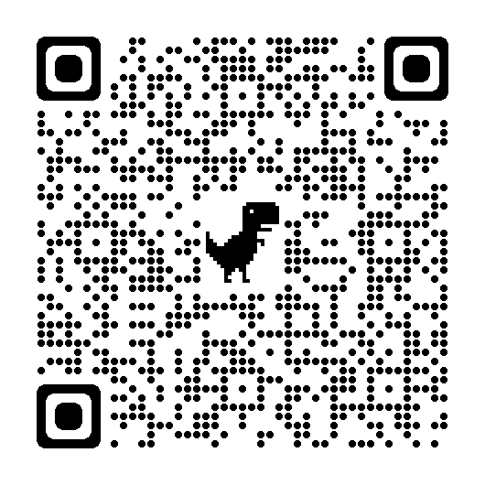
Registered Nursing Degree Apprenticeship (RNDA)
Not offering in 2025-2026
Healthcare professionals with the right skills, qualifications and experience can take their career in a new direction by completing a degree-level nursing apprenticeship
Offered as a Level 6 degree apprenticeship, leading to a Bachelors degree and full Registered Nurse status on completion
Usually takes 3-4 years (depending on the training provider)
Learning fits around the apprentice’s work commitments
Involves flexible theory learning, with clinical placements
Tuition fees are covered and RNDA’s are employees of the Trust
Applicants must have maths and English at Level 2 (GCSE or equivalent)
https://www.prospects.ac.uk/
jobs-and-work-experience/
job-sectors/healthcare/nursing
-apprenticeships
https://www.healthcareers.nhs.uk/
career-planning/
study-and-training/nhs-apprenticeships

